Slide 1
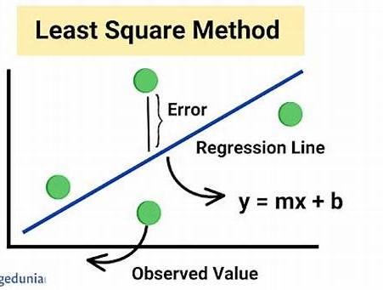
Least Squares Method
Least Squares method is a statistical technique used to find the equation of best-fitting curve or line to a set of data points by minimizing the sum of the squared differences between the observed values and the values predicted by the model.
The Best fit formula
y = mx + b

Slide 2
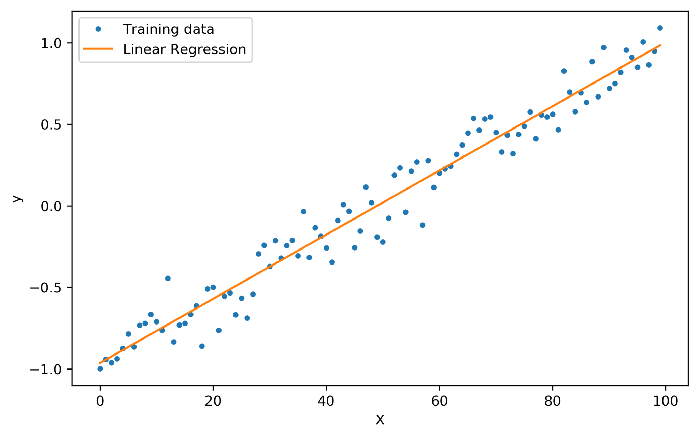
Linear Regression in Machine Learning
Linear regression is a statistical method used to model the relationship between a dependent variable and one or more independent variables. It provides valuable insights for prediction and data analysis.

Slide 3
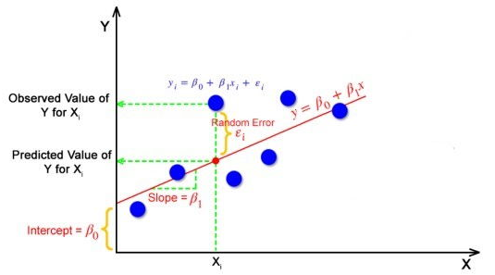
What is the best Fit Line?
The best Fit Line equation provides a straight line that represents the relationship between the dependent and independent variables.
The slope of the line indicates how much the dependent variable changes for a unit change in the independent variable(s).
The intercept provides a baseline for the dependent variable when the independent variables are at their minimum values (often zero).
Random error is a chance difference between the observed and true values

Slide 4
Hypothesis Testing in Linear Regression
t-Test for Individual Coefficients
Null Hypothesis: The predictor has no effect.
Alternative Hypothesis: The predictor has an effect.
F-Test for Overall Significance
Null Hypothesis: None of the predictors have an effect.
Alternative Hypothesis: At least one predictor has an effect.
Partial F-Test
Null Hypothesis: The simpler model is sufficient.
Alternative Hypothesis: The more complex model is better.
Wald Test
Null Hypothesis: The predictor(s) being tested have no effect.
Alternative Hypothesis: The predictor(s) being tested have an effect.
Likelihood Ratio Test
Null Hypothesis: The simpler model is sufficient.
Alternative Hypothesis: The more complex model is better.
Durbin-Watson Test
Null Hypothesis: There is no autocorrelation.
Alternative Hypothesis: There is autocorrelation.

Slide 5
Perform Hypothesis Testing on Coefficients: Testing if the features significantly affect the target
Null Hypothesis (H₀): Coefficient is zero (no effect)
Alternative Hypothesis (H₁): Coefficient is not zero (significant effect)
Check P-values: Evaluate the significance of each feature
Interpret Coefficients
Confidence Intervals for Coefficients
Model Improvement
Feature Engineering generalizability through k-fold cross-validation
Model Deployment
Real-Time Prediction
Define the Problem
Collect Relevant Data (Dependent and Independent Variables)
Split data into Training and Test Sets (e.g., 80-20 split)
Separate Features (X) and Target (y)
Data
Splitting
Model Evaluation
Model Exploration
Understanding the Problem and Data Collection
Data Exploration and Preprocessing (EDA)
Hypothesis Testing in Linear Regression
Model Building
Data Loading
Initial Data Exploration
Handle Missing Values
Detect and Handle Outliers
Feature Engineering
Hypothesis Testing
Correlation Analysis
Fit the Linear Regression Model: Train the model using Linear Regression or other frameworks
Make Predictions: Use the trained model to predict on test data
Evaluation Metrics: Calculate performance metrics like:
R² (R-squared)
MAE (Mean Absolute Error)
MSE (Mean Squared Error)
RMSE (Root Mean Squared Error)
Residual Analysis

Slide 6
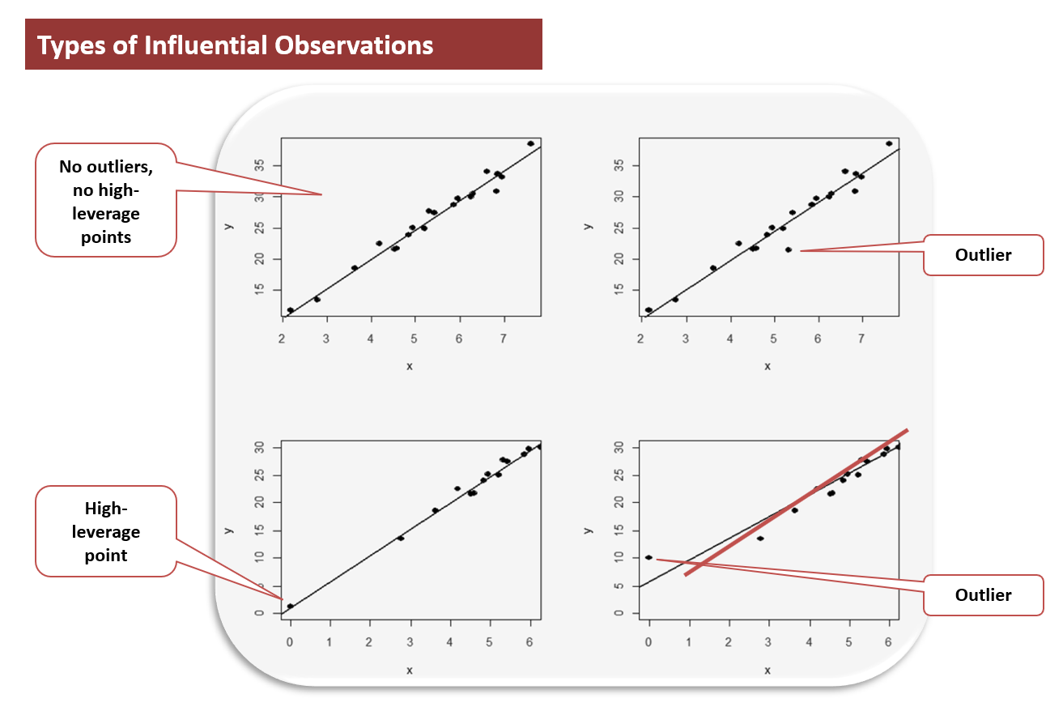
Influential Point
Leverage points are those that are far from the mean of the predictor variables and might have a significant impact on the model.
Cook’s Distance, DFFITS, Standardized Residuals, and DFBETAS can help identify points that disproportionately influence the regression coefficients and predictions.
Use multiple diagnostic measures to get a holistic view of influential data points.
By detecting and potentially removing or addressing these influential points, you can improve the robustness and reliability of your model.

Slide 7
 | Correlation coefficient: r | Regression coefficient: β1 (in the linear model: Y = β0 + β1X)
Objective | Measures the strength of the linear relationship between 2 variables: X and Y. | Describes the relationship between 2 variables: X and Y.
Range | [-1, 1] | (-∞, +∞)
Interpretation | • r close to -1 reflects a negative correlation between X and Y (as one increases, the other decreases). • r close to 0 reflects no correlation between X and Y (no linear relationship exists between the 2 variables). • r close to 1 reflects a positive correlation between X and Y (the 2 variables tend to increase and decrease together). | β1 is the unit change in Y corresponding to a 1 unit change in X. (for more details, see: Interpret Linear Regression Coefficients) Similar to the correlation coefficient r: • β1 < 0 reflects a negative correlation between X and Y. • β1 > 0 reflects a positive correlation between X and Y.
Strength | Does not depend on the units of measurement of X and Y. | Quantifies the amount of change in Y for a 1 unit change in X. β1 enables us to calculate the value of Y for different values of X.
Limitation | Cannot tell us what happens to Y if we change X by 1 unit. Does not tell us anything about the value of Y given X. | Depends on the units of measurement of X and Y.

Slide 8
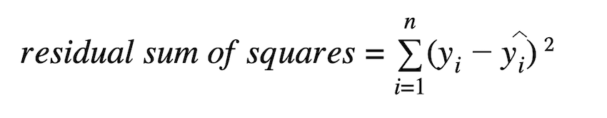
Residual sum of Squares
RSS represents the total squared error between the actual and predicted values.
It plays a crucial role in assessing the fit of a regression model. Lower RSS indicates better model performance.
RSS is minimized in Ordinary Least Squares (OLS) regression to find the best-fitting model.
R² and RSS are closely related, where a higher R² corresponds to a lower RSS.

Slide 9
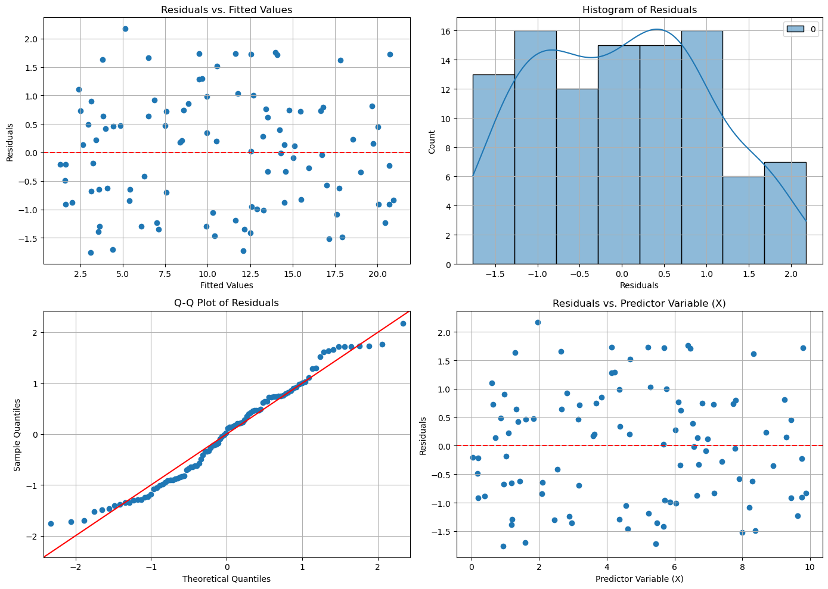
Why Perform Residual Analysis?
Residuals vs. Fitted Values: Look for randomness around the horizontal line at zero. Patterns or systematic structures indicate model inadequacies.
Histogram of Residuals: Check if the residuals are approximately normally distributed.
Q-Q Plot of Residuals: Check if the residuals follow a straight line, indicating normality.
Residuals vs. Predictor Variable (X): Check for any patterns that suggest non-linearity or interaction effects.

Slide 10
Metric | R-squared | Adjusted R-squared
Definition | Measures the proportion of variance in the dependent variable explained by the independent variables. | Adjusts the R-squared value based on the number of predictors in the model.
Range | 0 to 1 | 0 to 1 (can be lower than R-squared)
Effect of Adding Predictors | Always increases (or stays the same) regardless of the predictors' relevance. | Can decrease if the added predictors do not improve the model.
Usefulness | Good for understanding the overall fit of the model. | Better for comparing models with different numbers of predictors.
Limitation | Does not account for the number of predictors, which can lead to overfitting. | Penalizes the addition of unnecessary predictors, providing a more accurate measure of model performance.

Slide 11
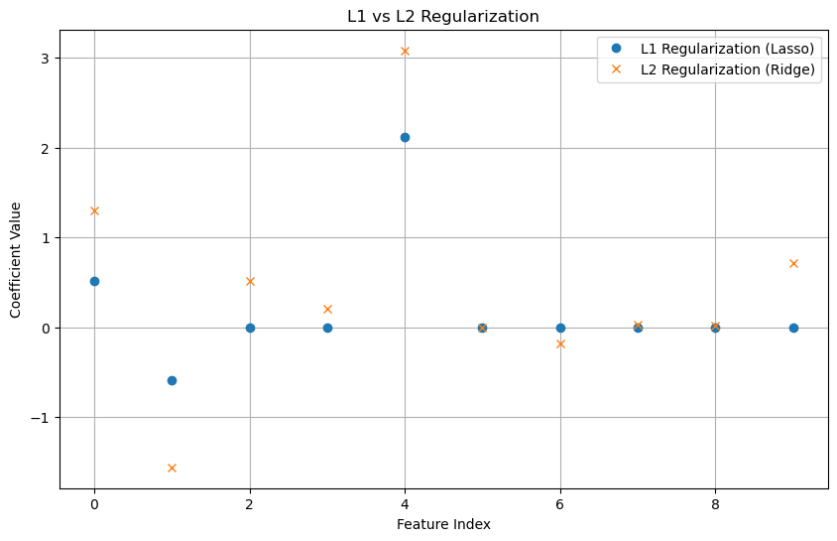
Lasso and Ridge Regression
Aspect | L1 Regularization (Lasso) | L2 Regularization (Ridge)
Definition | Adds the absolute value of the coefficients as a penalty term | Adds the squared value of the coefficients as a penalty term
Effect | Can produce sparse models with some coefficients set to zero | Produces models with small but non-zero coefficients
Use Case | Useful for feature selection and when many features are irrelevant | Useful when you want to keep all features but reduce the impact of less important ones
Bias-Variance Tradeoff | Increases bias, reduces variance | Reduces variance, slightly increases bias
Interpretability | Easier to interpret due to sparsity | Less interpretable due to non-zero coefficients
Example | Lasso Regression | Ridge Regression

Slide 12
Patterns in Linear Regression
1. Random Scatter (No Pattern):
What it shows: This is the ideal pattern. Residuals are randomly scattered around zero with no discernible shape or structure.
What it indicates: This indicates that the assumptions of linearity, homoscedasticity, and independence of errors are met.
Why it’s good: If the residuals exhibit random scatter, it suggests that the model has captured the underlying relationship between the independent and dependent variables, and the errors are equally distributed across all levels of the predictors.
2. Funnel or Cone Shape (Heteroscedasticity):
What it shows: As the predicted values increase, the spread of the residuals also increases (or decreases). The residuals form a funnel or cone shape.
What it indicates: This indicates heteroscedasticity — the variance of the residuals is not constant, which violates one of the key assumptions of linear regression.
Why it’s a problem: This means the model's error variance changes across the range of fitted values. This can affect the reliability of hypothesis tests and confidence intervals. Possible remedies include transforming the dependent variable or using weighted least squares (WLS) regression.
3. Curved Pattern (Non-Linearity):
What it shows: A clear curve (e.g., U-shaped or inverted U-shaped) pattern in the residual plot.
What it indicates: This suggests non-linearity in the data. The relationship between the independent and dependent variables might not be linear, even though you’re using a linear regression model.
Why it’s a problem: If the residuals show a curve, it means that the model isn't adequately capturing the true relationship, and a linear model might not be the best choice. You may need to add polynomial terms or try a non-linear model.
4. Fan-Shaped Pattern (Non-constant Variance):
What it shows: Similar to the funnel shape but typically with an increasing or decreasing spread that fans out or contracts as the fitted values change.
What it indicates: This is also a sign of heteroscedasticity, just like the funnel-shaped pattern. The variance of residuals changes as the predicted values increase or decrease.
Why it’s a problem: Again, this violates the assumption of homoscedasticity. It may suggest that the model doesn’t account for some variable or that the variance of the errors increases with the magnitude of the response.

Slide 13
5. Horizontal Bands (Outliers or Influential Points):
What it shows: The residuals form distinct horizontal bands or clusters.
What it indicates: This can indicate that there are outliers or influential data points in the dataset that are disproportionately affecting the model.
Why it’s a problem: Outliers can distort the fit of the regression model and affect statistical significance. It’s important to investigate these points, possibly removing or addressing them if necessary.
6. Clusters or Gaps in Residuals (Autocorrelation):
What it shows: The residuals might show clustering or gaps at certain points.
What it indicates: This suggests autocorrelation in the residuals, which occurs when the residuals at one observation are correlated with the residuals at another observation.
Why it’s a problem: Autocorrelation violates the assumption that the residuals are independent of each other. This can happen in time series data, where values from earlier time periods are related to later ones. If autocorrelation is present, you might need to use time series models like ARIMA or include lagged variables.
7. Point-Specific Residuals (Outliers or Leverage Points):
What it shows: Some residuals are much larger than others, or a few points are far from the main cluster.
What it indicates: These points may be outliers or high-leverage points. High-leverage points are those with extreme values in the predictor variables, and outliers are those with extreme values in the response variable.
Why it’s a problem: These points can disproportionately influence the regression model and may result in biased parameter estimates. It's worth investigating these points to determine if they should be included or if the model needs to be adjusted.
8. Random Horizontal Line (Incorrect Model Form):
What it shows: A flat horizontal line with evenly distributed residuals.
What it indicates: This can suggest that the model is too simple or that important predictors or relationships have been omitted.
Why it’s a problem: The residuals should show some variability if the model is adequately explaining the data. A perfectly horizontal line might suggest that the model is missing key relationships between variables, and you might need to reconsider your features or transformations.

Slide 14
Plots in Linear Regression to check Assumptions
Scatter Plots: Help you visually check the relationship between predictors. Strong correlations may indicate multicollinearity.
Residuals vs. Predicted Values Plot: Reveals potential issues with linearity and homoscedasticity. Look for random scatter around zero and constant spread.
QQ Plot: Checks if residuals follow a normal distribution. If they deviate from the line, it indicates non-normality.
Histogram of Residuals: Another check for normality. A bell-shaped histogram indicates normal residuals.
Correlation Matrix: Helps identify multicollinearity. High correlation between predictors suggests potential issues with model stability.

